Slide 1
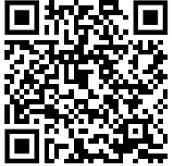
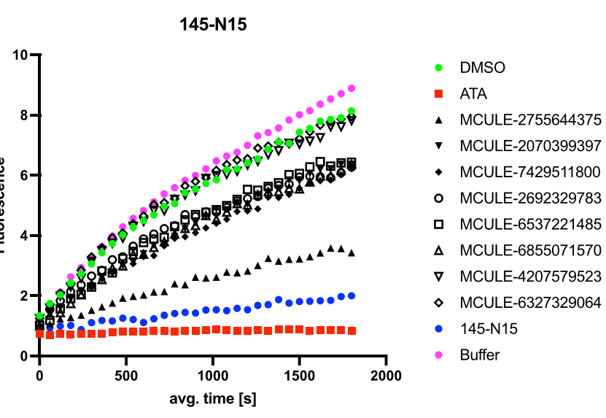

CNP27: SARS-CoV-2-NSP14 target-384 compounds
(Nick Heaton library) HTS
RA-0020083-01
The most
active hit
37 compounds shipped in April 2024 (30 purchased analogues for the three hits –Mcule + 7 synthetic analogues) tested by Nick Heaton.
To make
R=alkyl, aromatic ring, heterocycle
Shipped to Nick Heaton’s lab on 23-08-2024
Purchased and to be shipped this week to Nick Heaton’s lab
CNP27: https://github.com/StructuralGenomicsConsortium/CNP27-SARS-CoV-2-NSP14
Hadia Almahli

